Slide 1
DESIGN OF PATCH ANTENNA USING FEKO SOFTWARE DONE BY G SATHEESH

Slide 2
INTRODUCTION
A patch antenna, also known as a microstrip antenna, is a type of radio antenna that consists of a flat, rectangular (or other shaped) conductive patch mounted on a dielectric substrate with a ground plane beneath it. These antennas are widely used in wireless communication systems due to their low profile, lightweight, and ease of fabrication.
Despite their advantages, such as simplicity and suitability for modern wireless applications like Wi-Fi, GPS, and 5G, they have limitations, including narrow bandwidth and relatively low gain. However, advancements in design techniques, such as the use of array configurations and dielectric modifications, have helped overcome these challenges, making patch antennas essential components in modern communication and radar systems.

Slide 3
DESIGN PROCESS
Open CADFEKOLaunch FEKO and start a new project in CADFEKO (geometry modeling tool).
Create Ground PlaneDraw a rectangle for the ground plane.Set size (e.g., 60 mm × 50 mm for a 2.4 GHz antenna).Assign PEC (Perfect Electric Conductor) material.
Create Dielectric SubstrateAdd a rectangle above the ground plane.Set thickness (e.g., 1.6 mm).Assign dielectric material (e.g., FR-4 with εr = 4.4).
Create PatchDraw a smaller rectangle for the patch.Set dimensions (e.g., 38 mm × 30 mm).Place it on top of the substrate.

Slide 4
Add Feed (Coaxial or Microstrip)Use a coaxial probe or microstrip feed at an optimized position.Define excitation port to apply a signal.
Set Boundary ConditionsAssign a radiation boundary to simulate free space.
Mesh and SimulateGenerate automatic mesh for accuracy.Run the solver to simulate the antenna.
Analyze ResultsCheck S11 parameter (return loss).View the radiation pattern and gain.

Slide 5
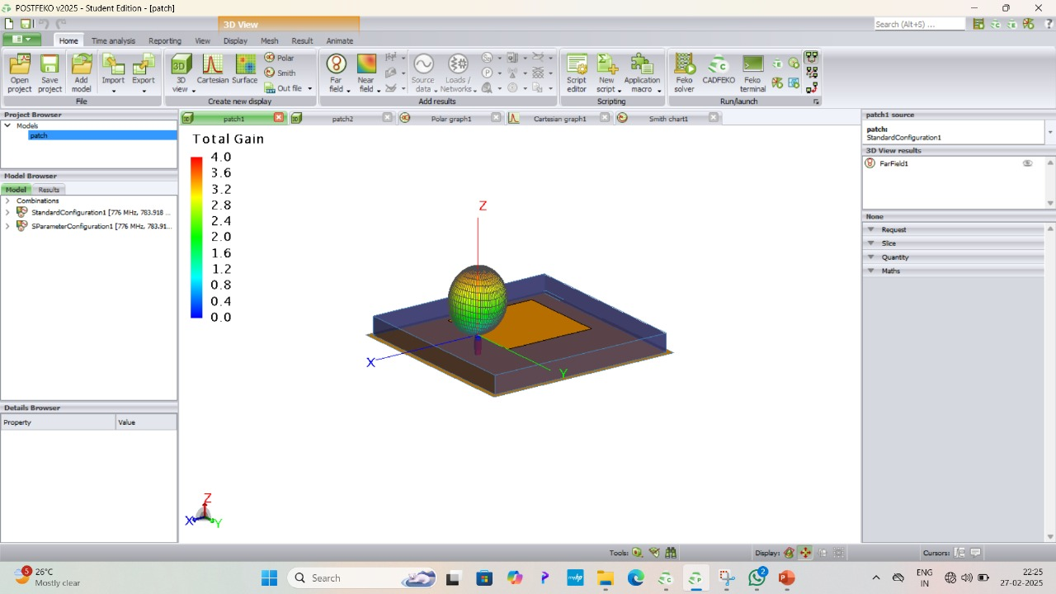
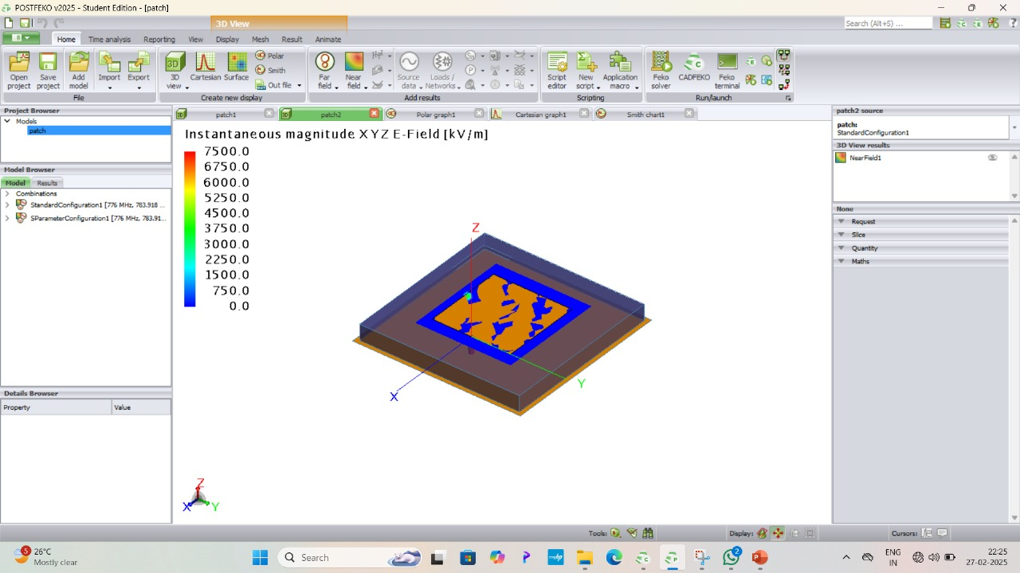
RESULTS
The first image shows the electric field distribution of a microstrip patch antenna simulated in FEKO, while the second image represents the far-field radiation pattern, indicating the antenna's gain and directional properties. Let me know if you need further analysis or modifications!

Slide 6
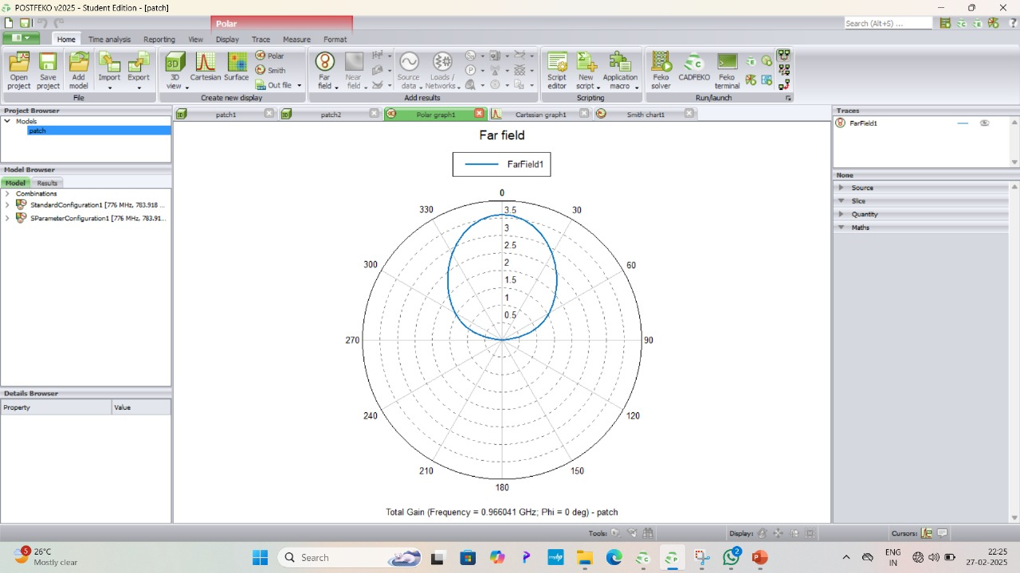
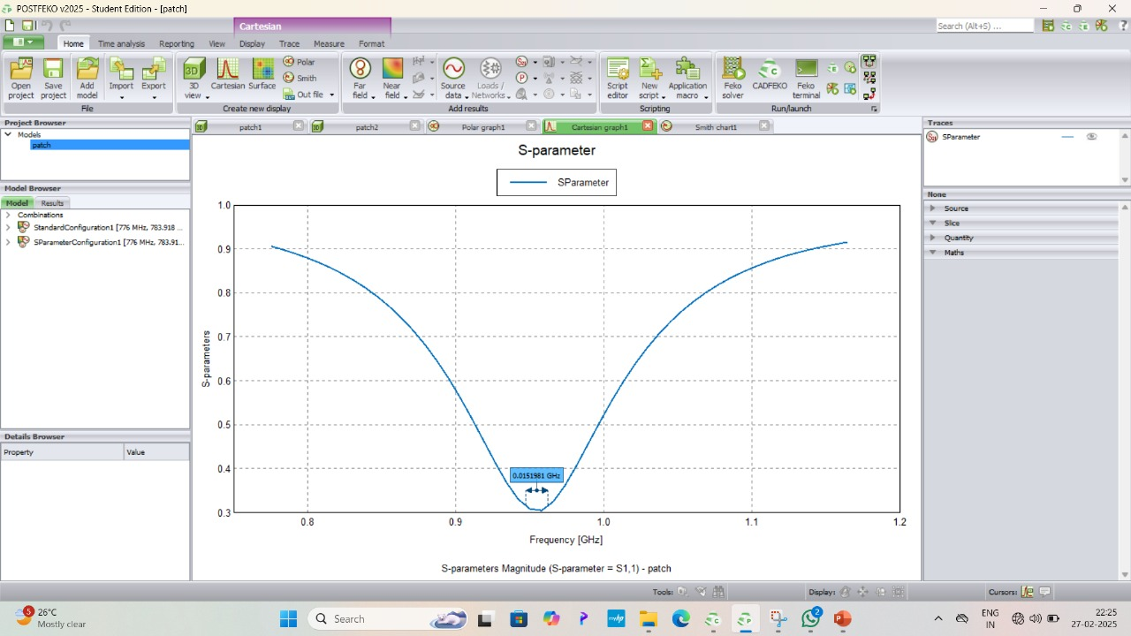
The first image shows the far-field radiation pattern of the patch antenna, indicating its directional gain. The second image presents the S-parameter (S11) plot, showing a resonance frequency around 0.951 GHz, which determines the antenna's operating frequency.

Slide 7
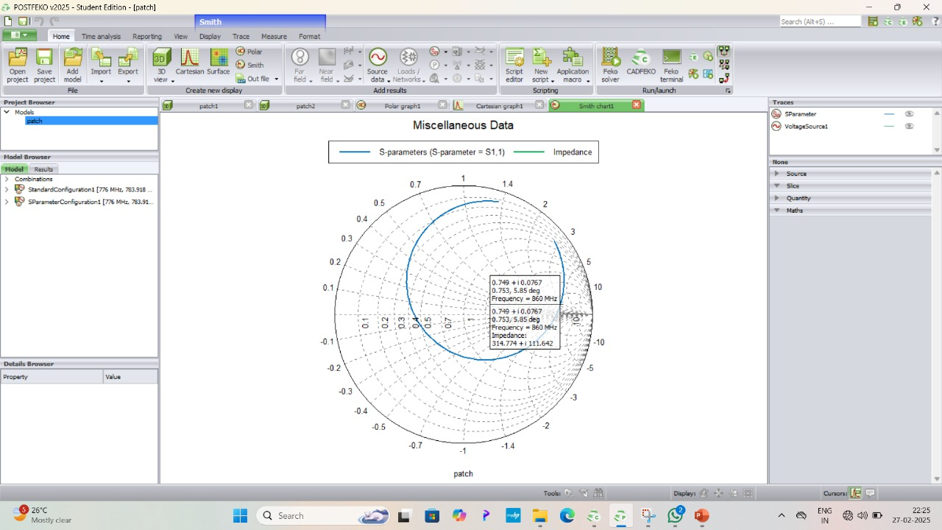
The Smith chart in the image represents the impedance characteristics of the patch antenna. At 860 MHz, the impedance is 314.77 + j111.642 Ω, indicating a mismatch with the standard 50 Ω impedance, which affects the antenna's efficiency.

Slide 8
THANK YOU

